Slide 1
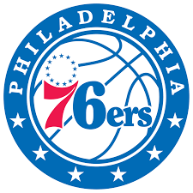
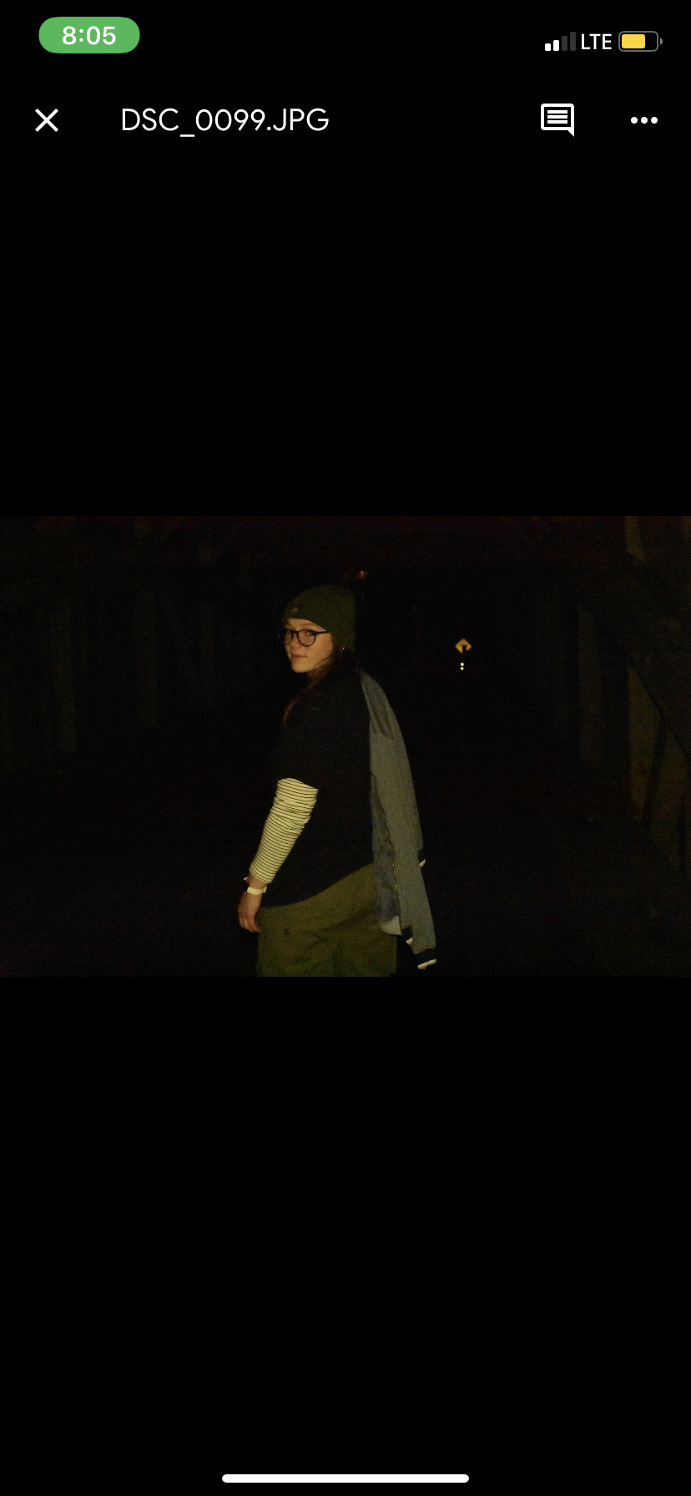
76ers
Ryan Johnson
Cassidy Klein
Chloe Pauls

Slide 2
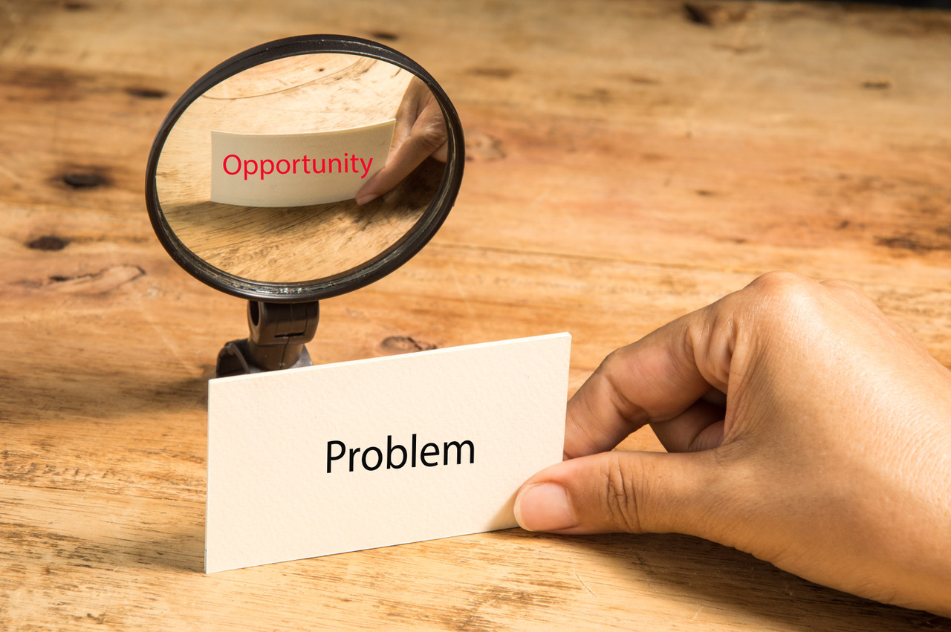
Opening
Problem: Need to increase engagement among 76er fans during the 2020-21 season
Opportunity: Use strategies and promotional elements from the NBA bubble to potentially increase engagement next season
Notes:
The Philadelphia 76ers are trying to increase fan engagement among their fans for the 2020-21 NBA season starting on December 22nd. The 2020 NBA restart provided a unique opportunity for teams to develop new strategies to engage fans without having them in attendance. Information gained from these new strategies can be used to inform decisions for next season.

Slide 3
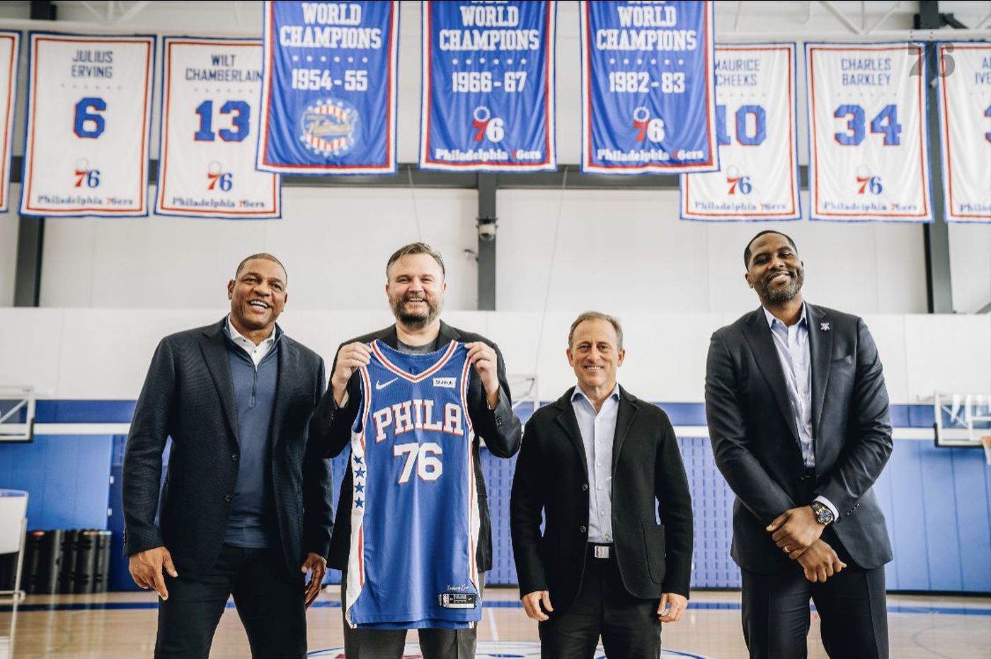
Current Situation
Wells Fargo Center
Eastern Conference
3 straight playoff appearances
Coach: Doc Rivers
President of Basketball Ops: Daryl Morey
Notes:
The Sixers currently play at the Wells Fargo Center in Philadelphia, PA. They are in the Eastern Conference and have made the playoffs in 3 straight seasons. After the 2020 season, the sixers hired a new coach, Doc Rivers formerly of the Los Angeles Clippers and a new president of basketball operations Daryl Morey from the Houston Rockets. The sixers have failed to reach the NBA finals and the Eastern Conference Finals during their 3 straight playoff appearances.

Slide 4
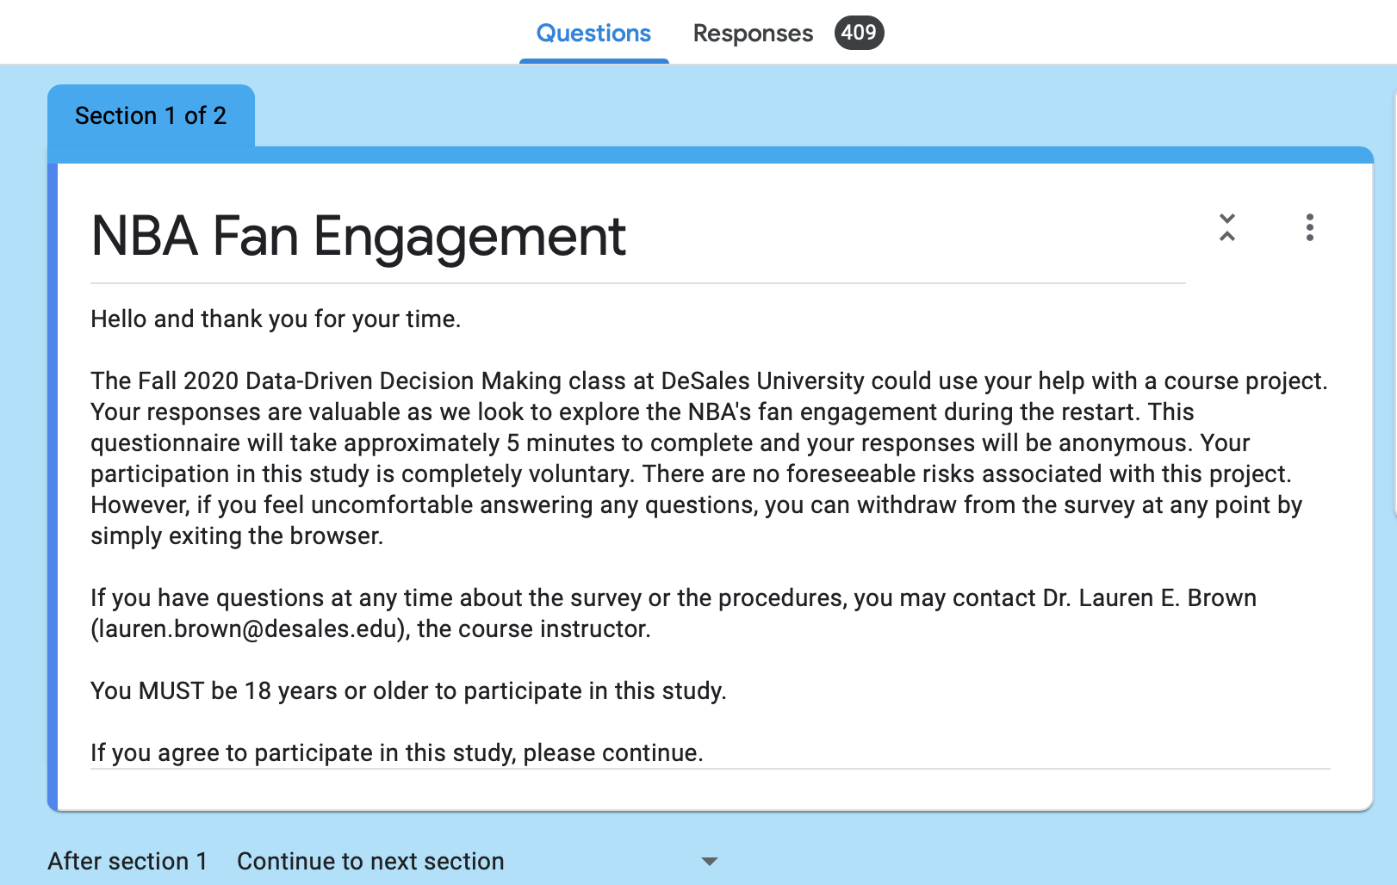
Method of Data Collection
Survey
Google Form
Sent out via: Instagram, Facebook, Snapchat and Twitter
Time: 5 to 10 minutes
Notes:
A Google Form survey was developed by the research team to gather fan opinions on specific fan engagement elements. The survey was sent out via various social media platforms, specifically Instagram, Facebook, Snapchat and Twitter. The survey had an estimated completion time between 5 and 10 minutes, the participants could opt out at any time and they were not asked to give their names.

Slide 5
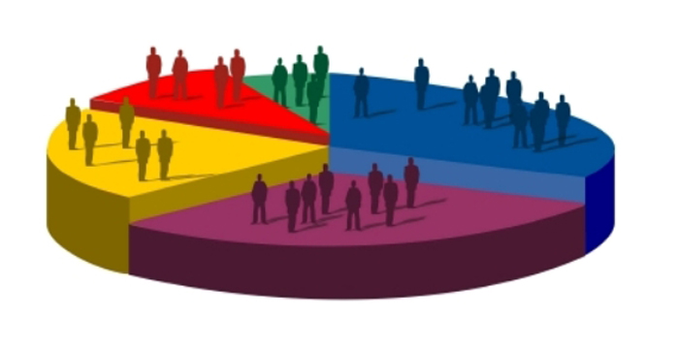
Data collection breakdowns (Demographics)
409 total respondents
167 76ers as favorite team
146 White/Caucasian
8 Hispanic/Latinx
134 Male
147 live in PA
134 ages 18-24
Notes:
The survey conducted gathered a total of 409 respondents, with 167 identifying the Sixers as their favorite team. All of these respondents did not answer every question. The demographics provided Of the Sixers fans, 146 identified as white while only 16 identified as a different race. Only 8 respondents respondents identified as Hispanic or Latinx. 134 respondents identified as male, 27 female and 2 nonconforming. 147 respondents live in PA with only 17 residing somewhere else. And ages 18-24 had the most respondents with 134. The survey, specifically of 76ers fans, had a disproportionate amount of college aged, white males who reside in PA.

Slide 6
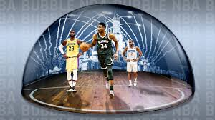
Key Findings
Matisse Thybulle Vlogs
Social Medias : Instagram and Twitter
Merchandise
Favorite player
NBA Bubble
NBA experience rating

Slide 7
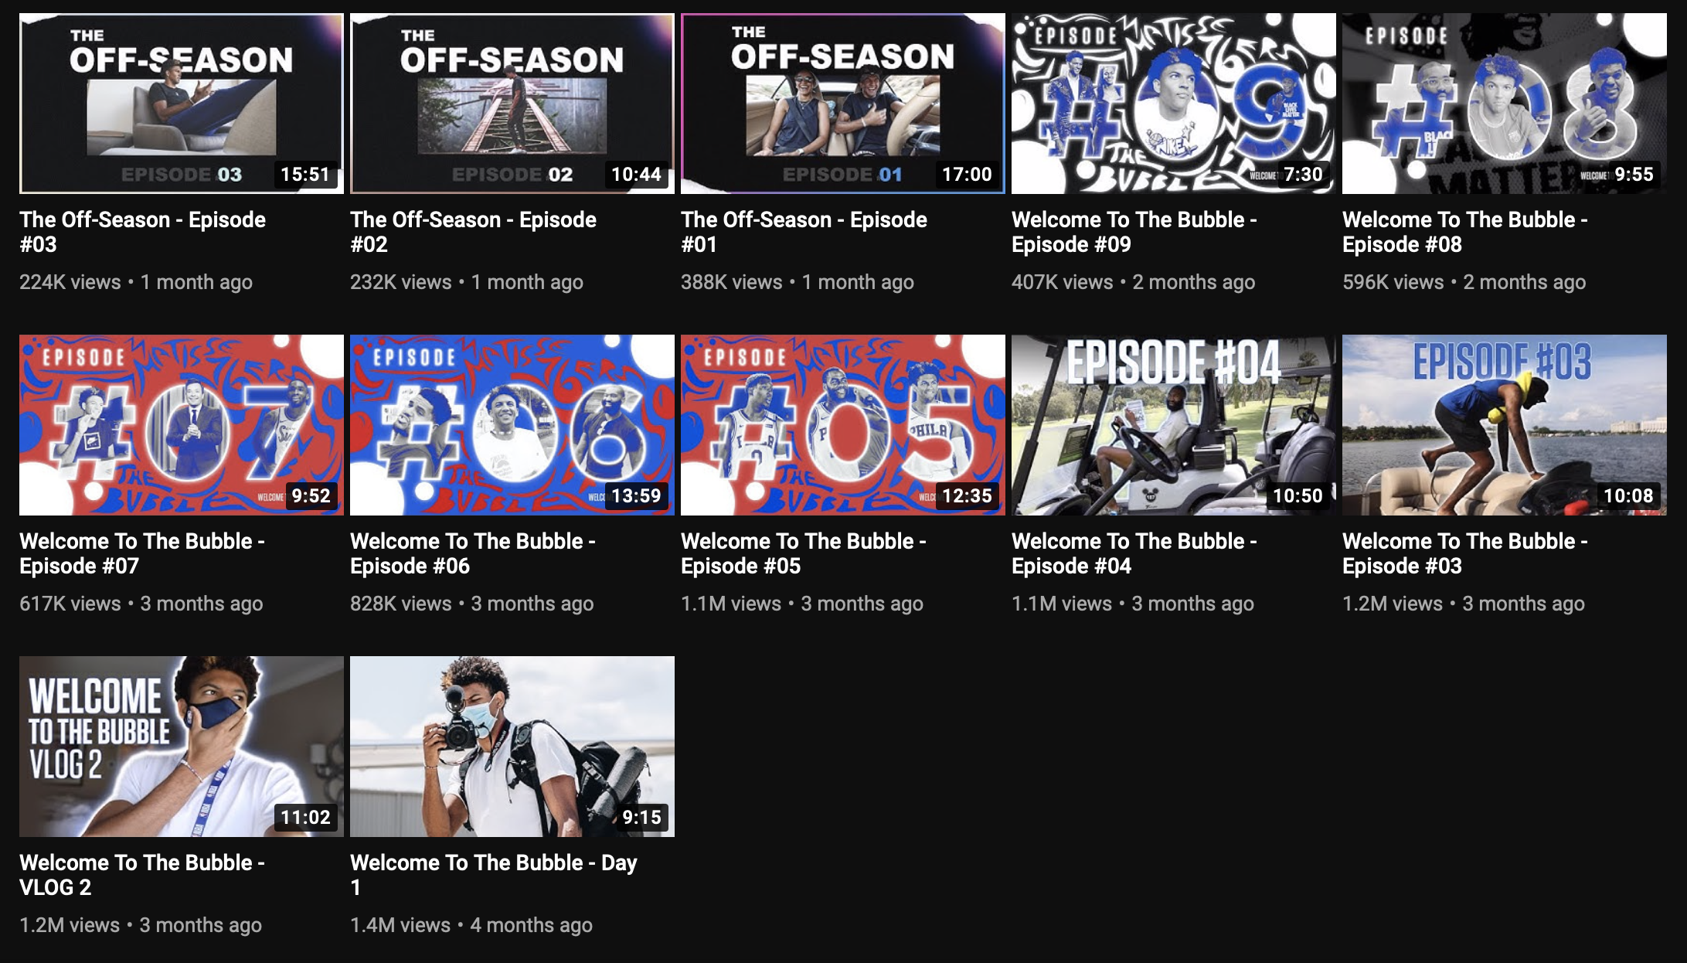
Matisse Thybulle
Notes:
Matisse Thybulle is a shooting guard and small forward for the Sixers who was drafted by them as the 20th pick in the first round of the 2019 draft. Matisse gained popularity during the NBA bubble as on July 11th he created his YouTube channel, Matisse Thybulle, and uploaded his first video “Welcome To The Bubble- Day 1.” Of the 9 total NBA Bubble “vlogs” Matisse uploaded, 5 had over 1 million views. Matisse joined YouTube on July 11th, 2020 and already has 401 thousand subscribers and about 9.6 million views. In the survey we conducted, 60 of the 167 respondents who were sixers fans highlighted his vlogs as ones they have viewed.

Slide 8

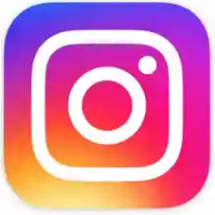
Social Media
Twitter
Used by 48.3% of the respondents (among all respondents)
In-season posts VS. off-season
Video edits and game photos
Thread posts
Individual players’ tweets
Instagram
Used by 81.1% of the respondents (among all respondents)
Top 2 posts
Ben Simmons - September 8th
Doc Rivers - October 3rd
Notes:
How much media is being put out vs what
Adds on social medias

Slide 9
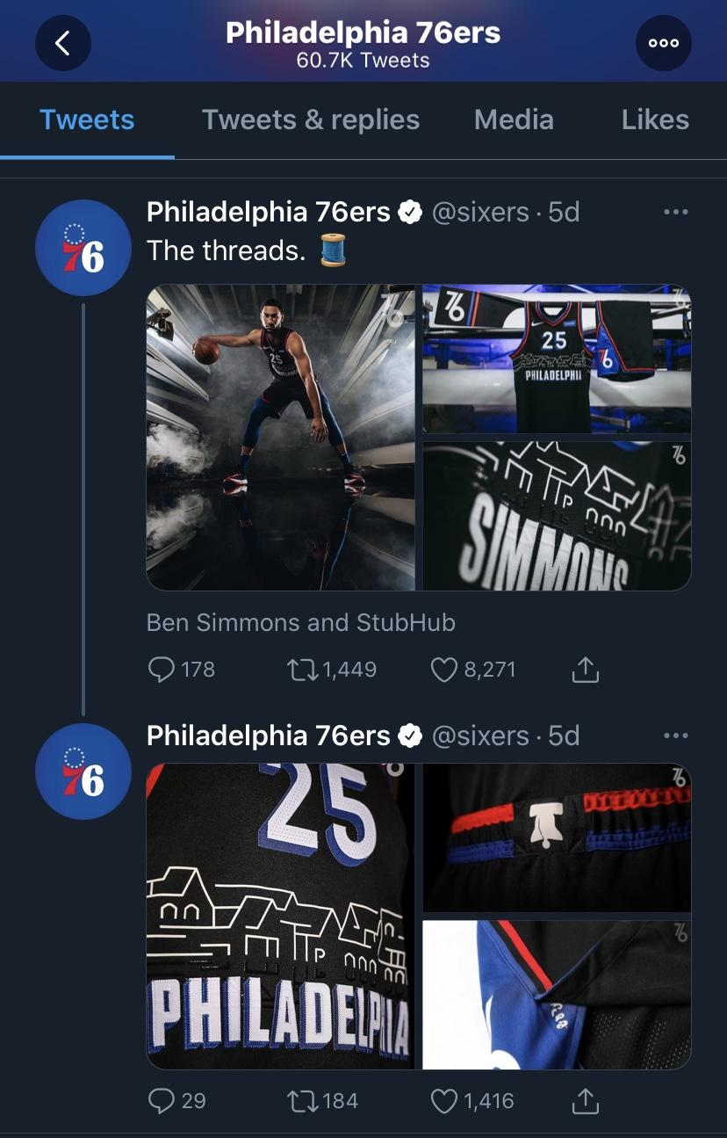
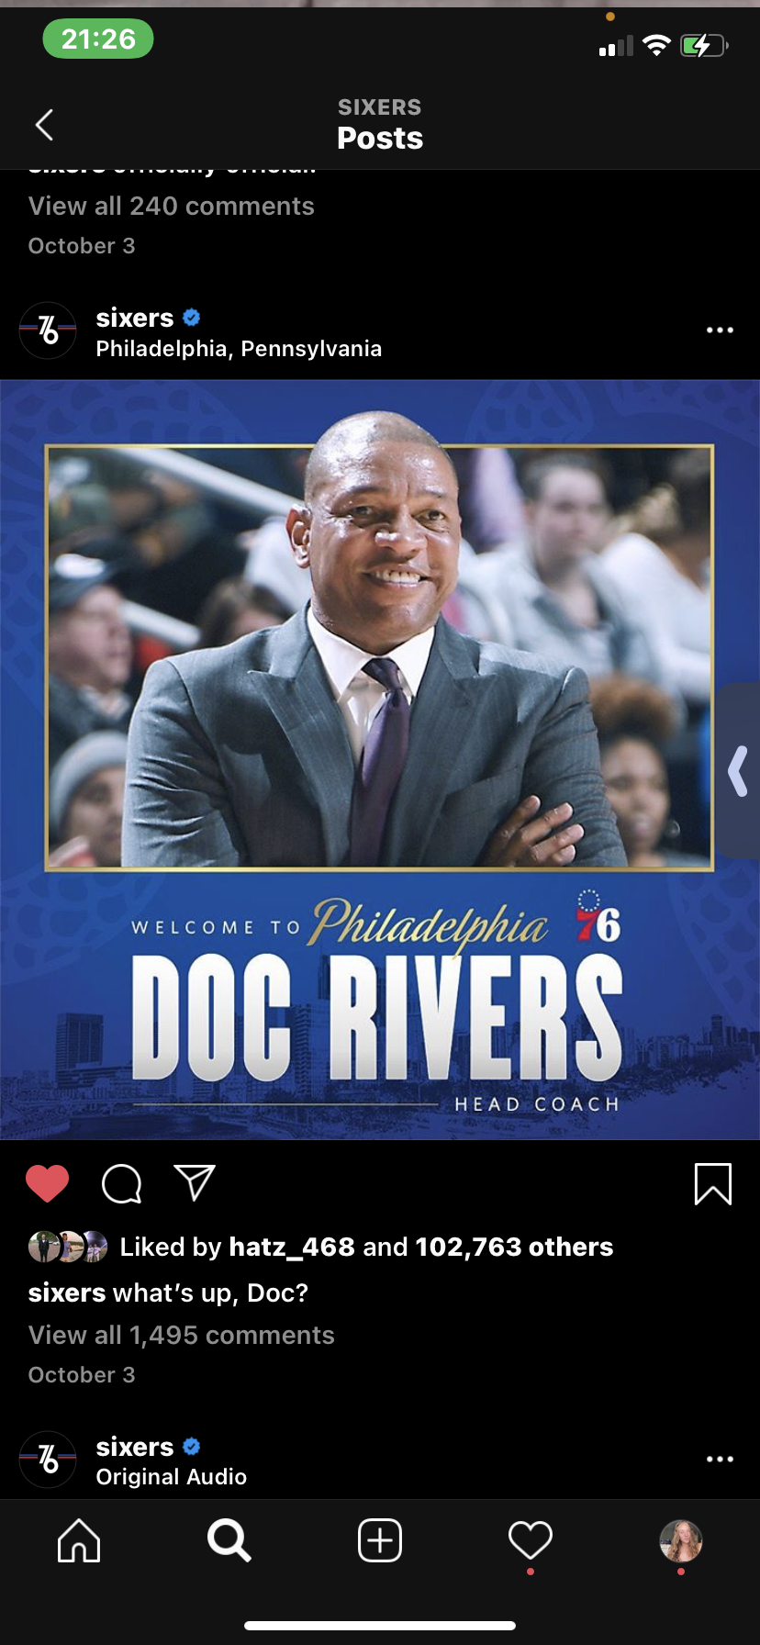
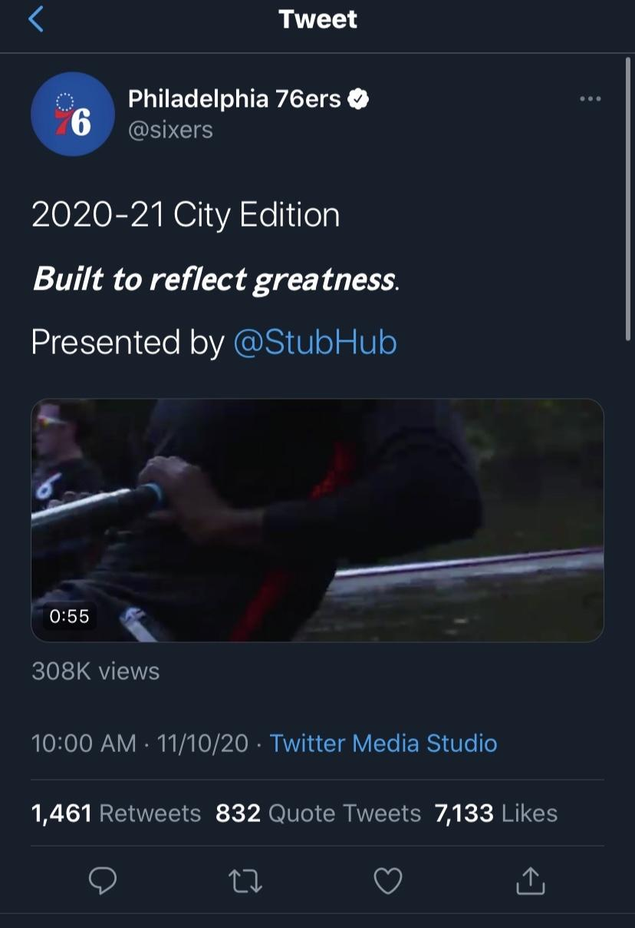
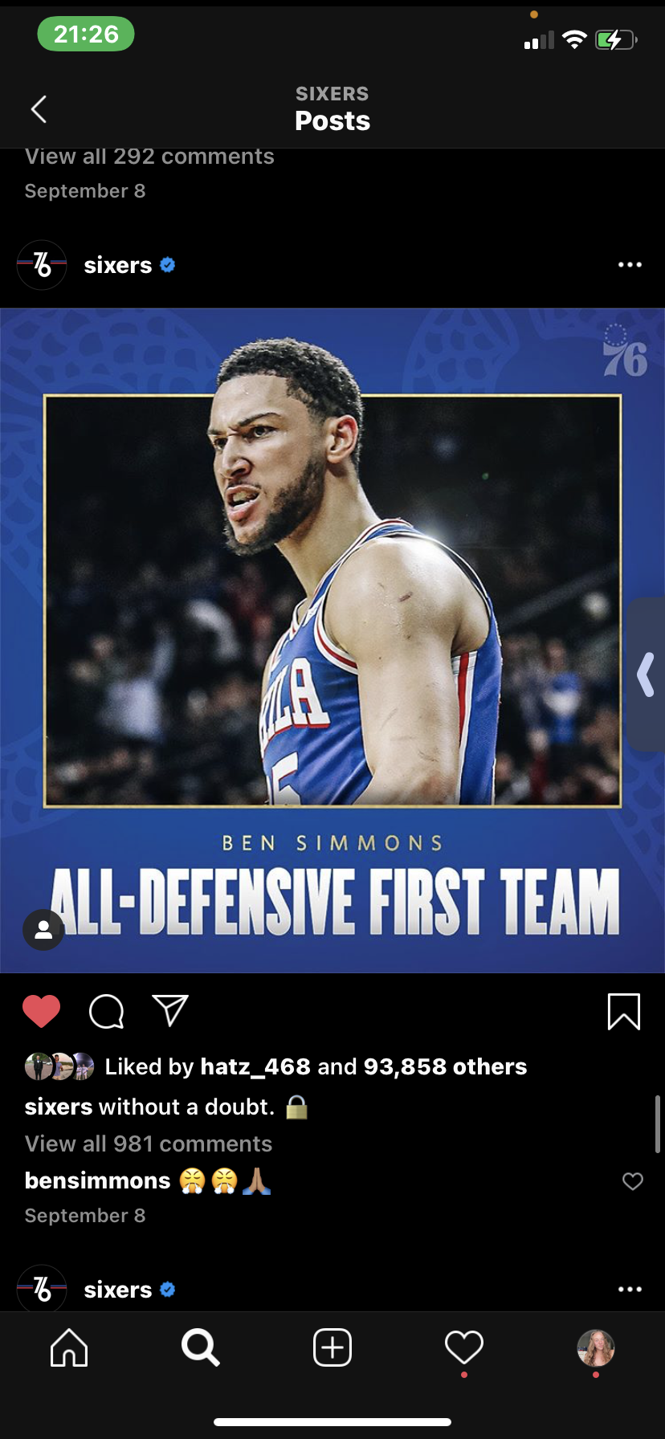

Slide 10
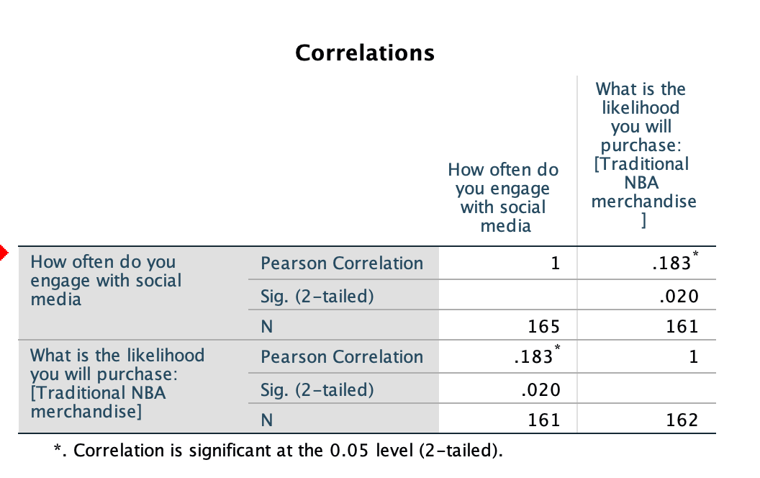
Correlation
Merchandise vs how often people engage in social media
156 people engage with social media daily
the significance level is below point .05
The correlations are weak the significance level is below point .05.

Slide 11
Merchandise
What is the likelihood you will purchase traditional NBA merchandise?
80 likely
27 unlikely
32 very likely
23 very unlikely
What is the likelihood you will purchase: [NBA social justice merchandise]
35 likely
45 unlikely
9 very likely
72 very unlikely
Notes:
Merchandise vs how often people engage in social media

Slide 12
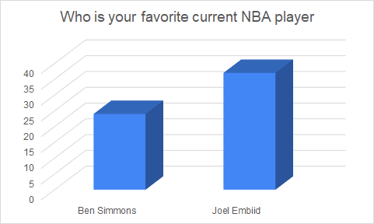
Favorite Current NBA Players
Notes:
HISTORY
Ben simmons - Position: Point Guard ▪ Shoots: Left
6-10, 240lb (208cm, 108kg)
Born: July 20, 1996 (Age: 24-116d) in Melbourne, Australia au
College: LSU
High School: Montverde Academy in Montverde, Florida
Recruiting Rank: 2015 (1)
Draft: Philadelphia 76ers, 1st round (1st pick, 1st overall), 2016 NBA Draft
NBA Debut: October 18, 2017
Experience: 3 years
Joel Embiid- Position: Center ▪ Shoots: Right
Born: March 16, 1994 (Age: 26-242d) in Yaounde, Cameroon cm (central africa)
College: Kansas
High Schools: Montverde Academy in Montverde, Florida, The Rock School in Gainesville, Florida
Recruiting Rank: 2013 (16)
Draft: Philadelphia 76ers, 1st round (3rd pick, 3rd overall), 2014 NBA Draft
NBA Debut: October 26, 2016 with the 76ers
Experience: 4 years
Speaks 4 languages
Of 166 respondents, 37 chose Joel Embiid and 24 chose Ben Simmons as their favorite players respectively

Slide 13
NBA Bubble
The NBA bubble offered some new features. They included:
New camera angles, mic’d up players, player vlogs, podcasts, artificial crowd noise, virtual fans, virtual town halls, featuring the families of players inside the bubble, trivia, as well as focusing on social justice initiatives
Of the various responses, many of these had positive reactions from fans who watched the NBA bubble.

Slide 14
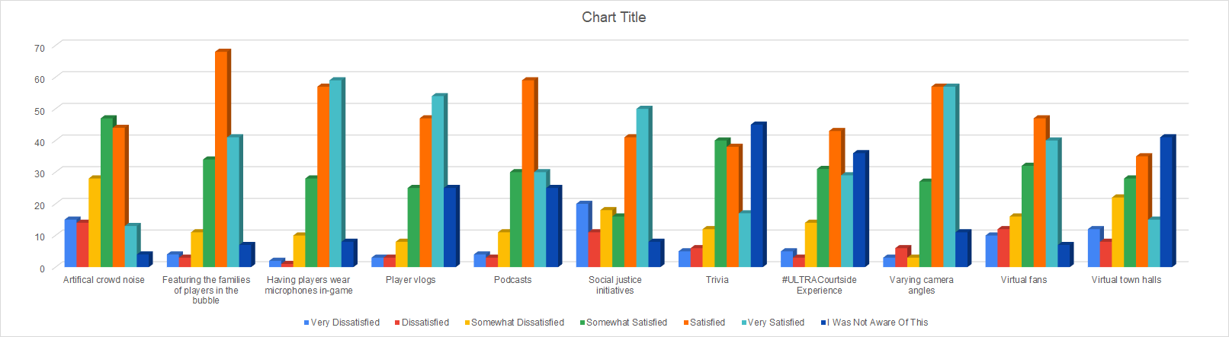
Please offer your feelings on each of the following aspects of the summer 2020 NBA experience:
Notes:
The light blue correlates to a very dissatisfied response, red correlates to a dissatisfied response, yellow correlates to somewhat dissatisfied, green correlates to somewhat satisfied, orange correlates to satisfied, aqua correlates to very satisfied and the dark blue correlates to the respondent not knowing of this feature
The artificial crowd noise had some mixed reviews. Overall majority showed that most people were somewhat satisfied or satisfied overall with the artificial crowd noise
The featuring of players’ family members in the bubble had a very positive response from fans, most of which being satisfied but also very satisfied and somewhat satisfied
Having mic’d up players also brought in a lot of positive responses, most of which being very satisfied and satisfied. There were only about a dozen all together who chose a response from somewhat dissatisfied through very dissatisfied.
Player vlogs showed positive feedback. Most responses were on some realm of satisfaction, the most being very satisfied. There was an increasing amount of responses that were unaware of player vlogs in the NBA bubble
Podcasts overall had a positive response, most of which being satisfied responses, but once again there were a large amount of people who did not know about the podcasts
Featuring social justice initiatives resulted in a large amount of very satisfied and satisfied responses. There were a higher amount of people with somewhat dissatisfied through very dissatisfied responses.
Trivia had a substantial amount of responses from people who were unaware of the trivia. Overall though, the people who knew of the trivia were fairly satisfied with it
The #ULTRACourtside Experience also had a large amount of responses from people who were unaware of this promotion. The feedback overall was positive, most responses were somewhere in between somewhat satisfied and very satisfied
Various camera angles showed extremely positive responses, majority of which were satisfied or very satisfied.
The virtual fans showed a little mix of responses. Majority were still very positive, being somewhere from somewhat satisfied through very satisfied but there were a larger portion of people who were leaning towards dissatisfaction than in some of the other aspects offered.
Virtual town halls showed a lot of responses of people who did not know about them. Overall there is still a large amount of respondents who were satisfied or somewhat satisfied

Slide 15
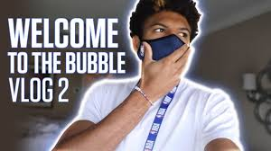
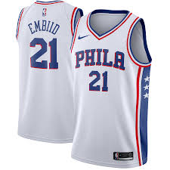
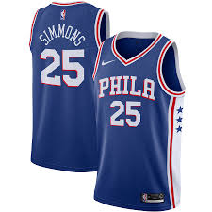
Recommendations
NBA Bubble
Social Media
Marketing Tactics
Player Vlogs

Slide 16
NBA Bubble
Utilizing tactics from the NBA bubble that had positive responses for future seasons
Artificial crowd noise and virtual fans
Podcasts, trivia, and player vlogs
Players should get mic’d up
Various camera angles

Slide 17
Social Media
Instagram and Twitter
Instagram
Use interactive stories
Tag merchandise in the posts using the business feature
Twitter
Encourage more engagement during off-season
Avoid using threads for posts
Encourage the players to retweet 76ers posts
Utilize popularity of video edits and action shots from games as well as photoshoots

Slide 18
Marketing Tactics
Joel Embiid and Ben Simmons are the 76er’s most popular players on the roster, therefore marketing them more heavily could add to more fan engagement.
A handful of players post Vlogs, it could be in the teams best interest to put forward those medias for more engagement

Slide 19
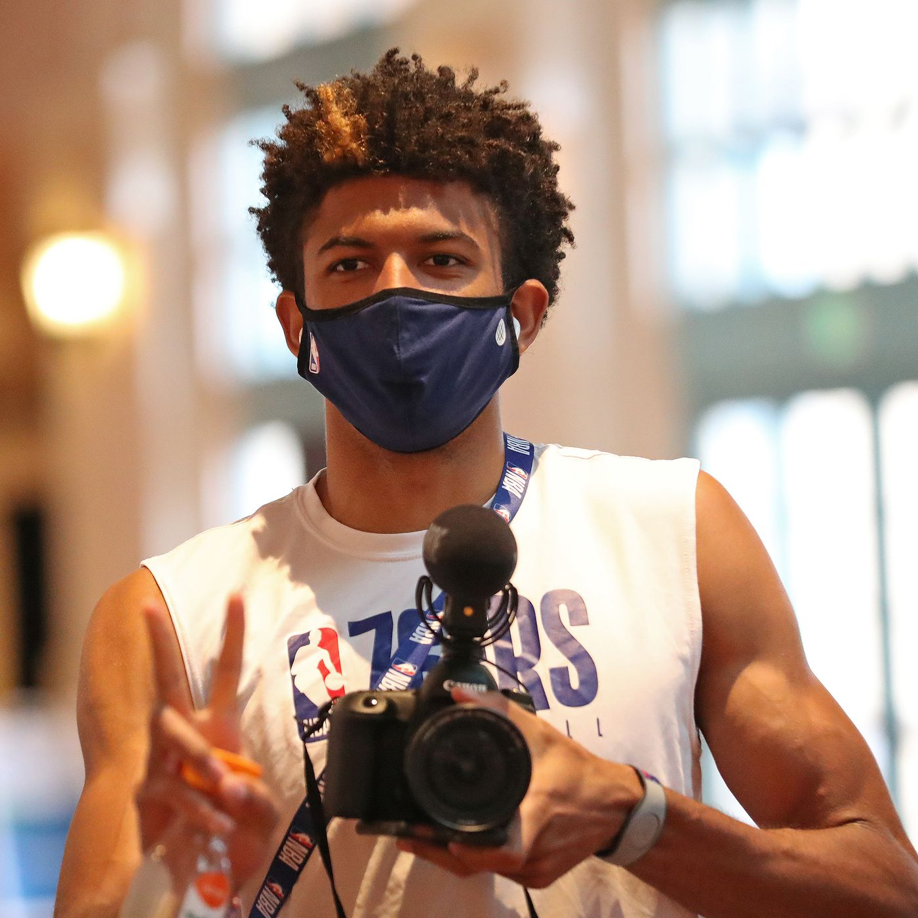
Matisse Thybulle Vlogs
Vlogs popularity increased in the bubble
Lack of media members (Pickman, 2020)
Matisse’s vlogs very popular among fans
Recommendation: promote and sponsor Matisse’s content
Notes:
As referenced by Ben Pickman in Sports Illustrated, the NBA bubble created a unique situation in which media members had massive restrictions on what they were allowed to see and where they were allowed to go. This created an opportunity for player made content to thrive as only they had the access fans were craving to see. The 3 most prominent vloggers were the Lakers Javale McGee, the Nuggets Troy Daniels and Sixers own Matisse Thybulle. McGee has had multiple bubble vlogs attain more than 2 million views, while Matisse has also done very well, with multiple vlogs reaching 1 million YouTube views. Matisse currently is sitting at 401 thousand subscribers, all of which were gained since the beginning of the bubble in July. Combining these figures with the popularity data gained from our survey, it is clear Matisse’s vlogs, and player vlogs in general are popular. The Sixers should look to promote and sponsor Matisse’s vlogs and further content creations throughout the 2020-21 NBA season.

Slide 20
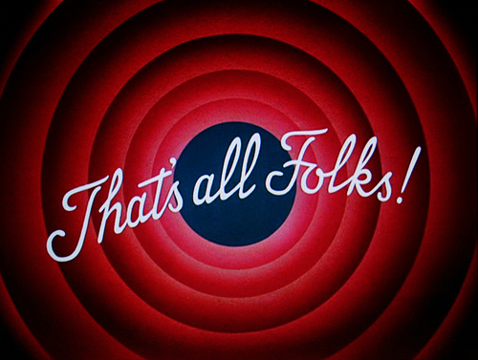
Closing
Positively viewed bubble tactics
Joel Embiid and Ben Simmons are biggest draws
Matisse Thybulle’s YouTube Channel

Slide 21
References
McGee, JaVale. “JaVale McGee.” YouTube, YouTube, www.youtube.com/channel/UCNlhQwl2hGoMRRsQK722cTg.
Pickman, B. (2020, July 29). How the NBA Bubble Became a Content Hub for Players. Retrieved November 16, 2020, from https://www.si.com/nba/2020/07/29/nba-bubble-content-vlogs-matisse-thybulle-javale-mcgee
Thybulle, Matisse. “Matisse Thybulle.” YouTube, YouTube, www.youtube.com/c/Matisse/videos.
“Philadelphia 76ers Franchise Index.” Basketball, Sportrader, 20 Oct. 2020, 4:30, www.basketball-reference.com/teams/PHI/.
76ers, P. (2020, November 10). The threads. pic.twitter.com/mDf4Mvk2V3. Retrieved November 16, 2020, from https://twitter.com/sixers/status/1326208015016595458

Slide 22
References
76ers, P. (2020, November 10). 2020-21 City Edition Built to reflect greatness.Presented by @StubHub pic.twitter.com/nyE3gIuyZc. Retrieved November 16, 2020, from https://twitter.com/sixers/status/1326177795693801474
(2020, September 8). Retrieved November 16, 2020, from https://www.instagram.com/p/CE5JU5rh7PZ/
(2020, October 3). Retrieved November 16, 2020, from https://www.instagram.com/p/CF4koj_B77Z/

